Slide 1
Flight Price Prediction Project
Submitted By:
SYED MUGERA BILAL
syedbilalarmaan@gmail.com

Slide 2
Contents
About the project
Business Goal
Data source & their formats
Hardware, Software and Tools
Data Analysis
Data Cleaning
Exploratory Data Analysis (EDA)
Splitting the data
Building Machine Learning Algorithms
Evaluation of ML Models
Result of ML Models
Key Metrics for success in solving problem under consideration
Conclusion

Slide 3
About the project
Anyone who has booked a flight ticket knows how unexpectedly the prices vary. The cheapest available ticket on a given flight gets more and less expensive over time. This usually happens as an attempt to maximize revenue based on –
Time of purchase patterns (making sure last-minute purchases are expensive)
2. Keeping the flight as full as they want it (raising prices on a flight which is filling up in order to reduce sales and hold back inventory for those expensive last-minute expensive purchases) So, you have to work on a project where you collect data of flight fares with other features and work to make a model to predict fares of flights.

Slide 4
Business Goal
Data Collection Phase
You have to scrape at least 1500 rows of data. You can scrape more data as well, it’s up to you, More the data better the model
In this section you have to scrape the data of flights from different websites (yatra.com, skyscanner.com, official websites of airlines, etc). The number of columns for data doesn’t have limit, it’s up to you and your creativity. Generally, these columns are airline name, date of journey, source, destination, route, departure time, arrival time, duration, total stops and the target variable
price. You can make changes to it, you can add or you can remove some columns, it completely depends on the website from which you are fetching the data.

Slide 5
Data Analysis Phase
After cleaning the data, you have to do some analysis on the data.
Do airfares change frequently?
Do they move in small increments or in large jumps?
Do they tend to go up or down over time?
What is the best time to buy so that the consumer can save the most by taking the least risk?
Does price increase as we get near to departure date?
Is Indigo cheaper than Jet Airways?
Are morning flights expensive?

Slide 6
Model Building Phase
After collecting the data, you need to build a machine learning model. Before model building do all data pre-processing steps. Try different models with different hyper parameters and select the best model.
Follow the complete life cycle of data science. Include all the steps like.
1. Data Cleaning
2. Exploratory Data Analysis
3. Data Pre-processing
4. Model Building
5. Model Evaluation
6. Selecting the best model

Slide 7
Data source and their format
We collected the data from website https://www.en.kayak.sa/flights/.The data is scrapped using Web scraping technique and the framework used is Selenium.
We scrapped nearly 1848 rows of the data and saved as csv file.

Slide 8
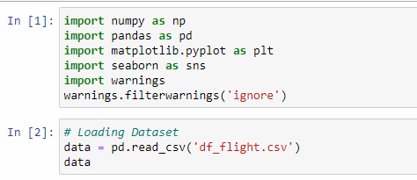
Hardware, Software and Tools
For doing this project, we require laptop with high configuration and specification with a stable Internet connection.
Microsoft office, Anaconda distribution as software.
Python 3.x as programming language.
Jupyter Notebook as Editor which is in Anaconda navigator.
Some tools or libraries required like Numpy – used to numerical calculations. Pandas – used to data manipulation. Matplotlib and Seaborn – used to data visualization.

Slide 9

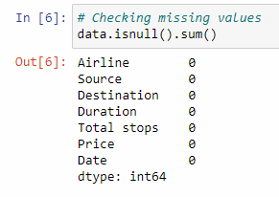
Data Analysis
The dataset has 1848 rows and 7 columns.
We have seen that, there is no missing values.

Slide 10
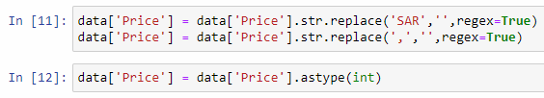
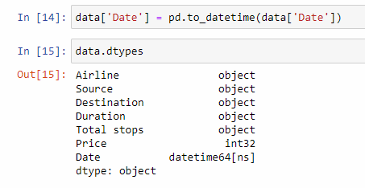
Data Cleaning
Removing word from object data and converting them into int data type.
Removing ‘,’ , ‘ ’ replacing missing data .
Removing unnecessary features.

Slide 11
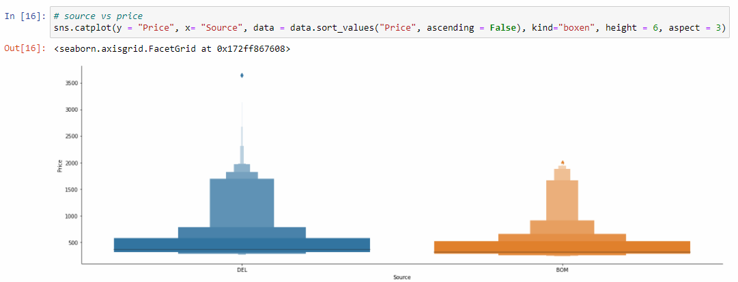
Exploratory Data Analysis (EDA)

Slide 12
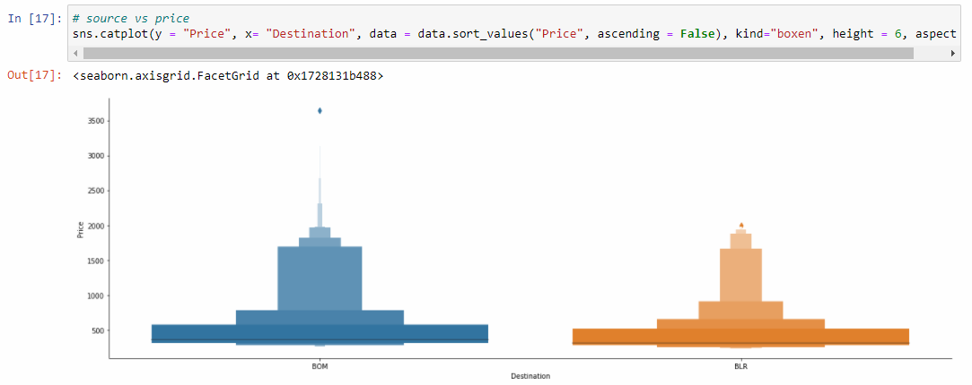

Slide 13
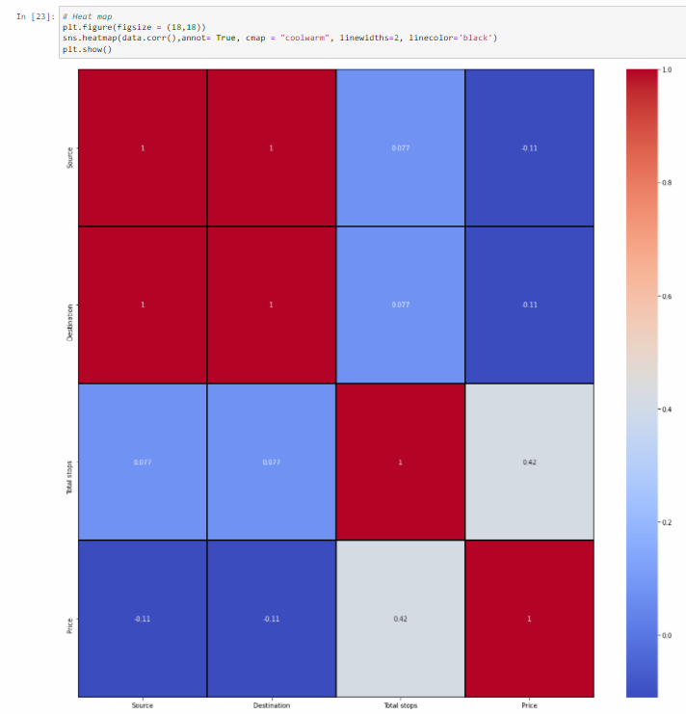
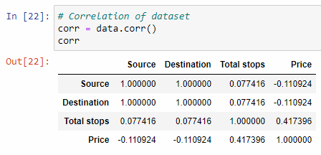
Multivariate Analysis

Slide 14
Splitting the data
We split our dataset into two parts training and testing, with 80% data of training and 20% of testing. We use train test split method.
80% of the observation as training set. x_train
The associated target for each observation in x_train , y_train
20% of the observation as test. x_test
The target associated with the test set. y_test
We found best score on random_state = 45

Slide 15
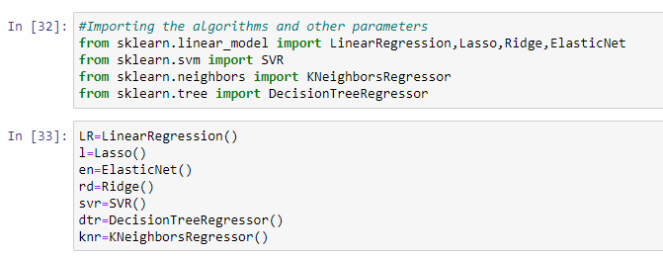
Building Machine Learning Algorithms
The following classifier algorithms we used are:
Linear Regression, Lasso, Ridge, ElasticNet
Decision Tree Regressor
KNeighbors Regressor
Random Forest Regressor, AdaBoost Regressor, Gradient Boosting Regressor

Slide 16
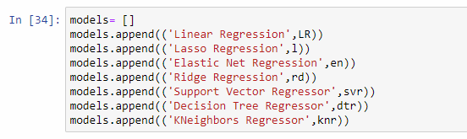
Evaluation of ML Models
As you can see , I had called the algorithms, then I called the empty list with the name models [ ], and calling all the model one by one and storing the result in that.
We can observe that I imported the metrics to find the r2_score, mean_absolute_error (MAE) ,mean_squared_error (MSE), root_mean_squared_error (RMSE) in order to interpret the model’s output. Then I also selected the model to find the cross_validation_score value.

Slide 17
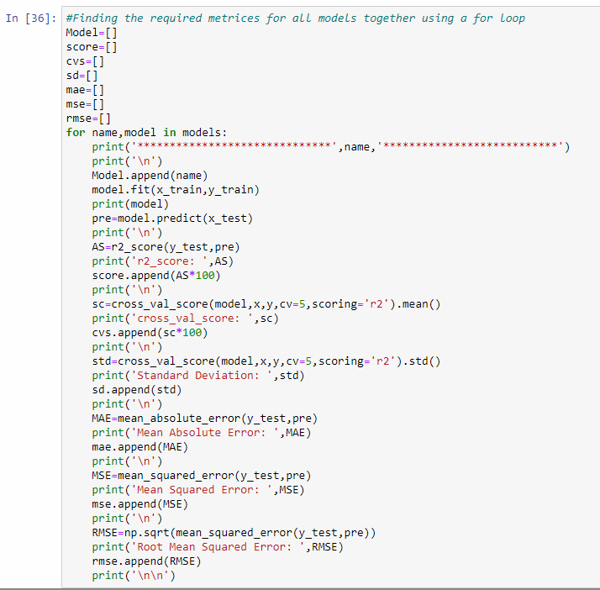
As you can observe, I made a for loop and called all the algorithms one by one and appending their result to models.
Let me show the output so that we can glance the result in more appropriate way.

Slide 18
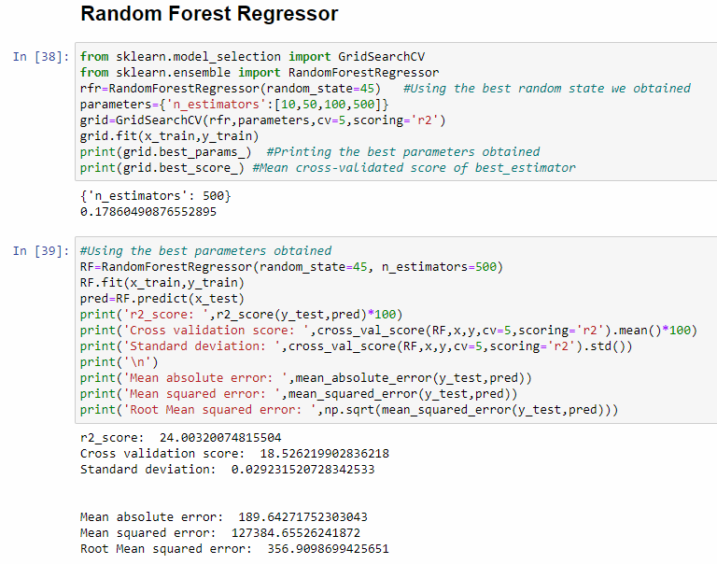

Slide 19
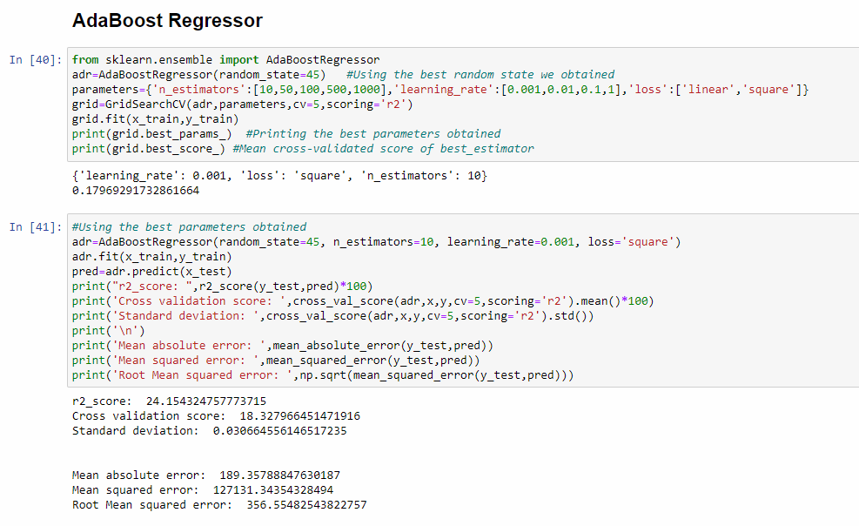

Slide 20
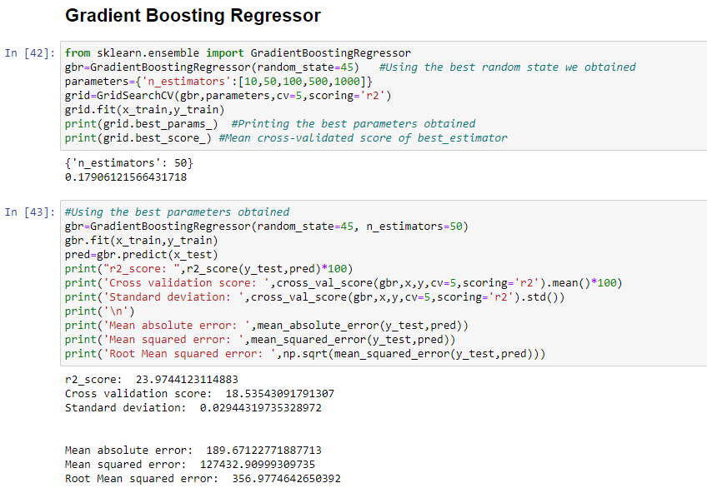

Slide 21
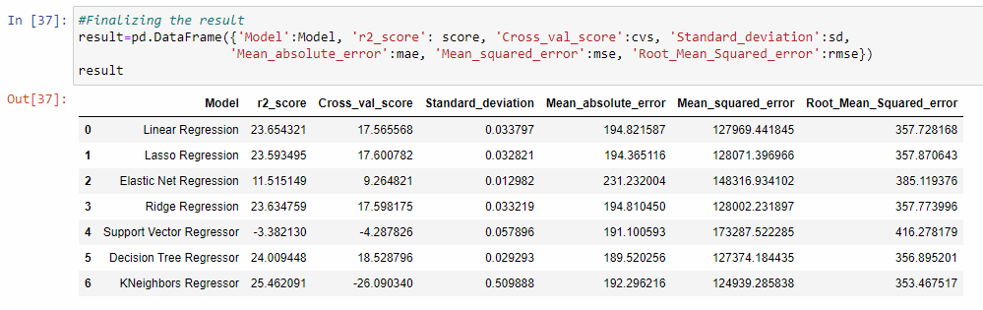
Result of ML Models
We saved result of ML Models in DataFrame.
We can see that Random Forest Regressor and KNeighbors Regressor are performing well compared to other algorithms. Now we will try Hyperparameter Tuning to find out the best parameters and try to increase the scores.

Slide 22
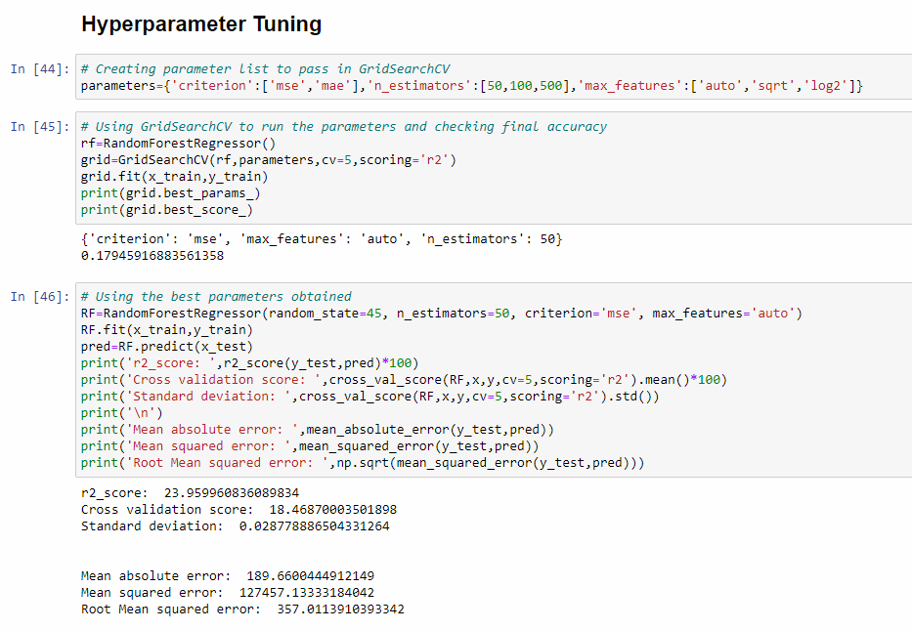

Slide 23
Key Metrics for success in solving problem under consideration
r2_score
Mean Absolute Error (MAE)
Mean Square Error (MSE)
Root Mean Square Error (RMSE)
Cross-validation
Hyperparameter Tuning using GridSearchCV
After applying Hyperparameter Tuning, we can see that RandomForestRegressor improve acuuracy r2_score slightly decreased. Now we will finalize the model.

Slide 24
Conclusion
After web scraping from https://www.en.kayak.sa/flights/ (using selenium) we making a dataset in csv format.
The target variable column [‘Price’] in SAR.
First, we loaded the dataset and did the EDA process and other pre-processing techniques checking and filling the missing data, converting categorical data into datetime format and numerical data, visualizing the of data, etc.
Then we did the model training, building the model and finding out the best model on the basis of different metrics scores we got like r2_score, Mean Absolute Error (MAE), Mean Square Error (MSE), Root Mean Square Error (RMSE), Cross-validation

Slide 25
We used algorithms like Linear Regression, Lasso Regression, Ridge Regression, ElasticNet, Decision Tree Regressor, KNeighbors Regressor, Random Forest Regressor, AdaBoost Regressor, Gradient Boosting Regressor
After performing the analysis, we got KNeighbors Regressor and Random Forest Regressor algorithm as the best algorithms among all. After that finding out the best parameter and improving the scores, we performed Hyperparameter Tuning.
The problem while doing Hyperparameter Tuning is that it took nearly 5 hours to fetch the best parameters.
After Tuning Random Forest Regressor is selected as the final model ,
We finalized the best model we obtained by saving the model in a pkl file.

Slide 26


